Slide 1



TRENDS & IMPACT IN OUR PROFESSION
Artificial Intelligence & Data Science
Presented By: Abishek S & Muhilan V

Slide 2


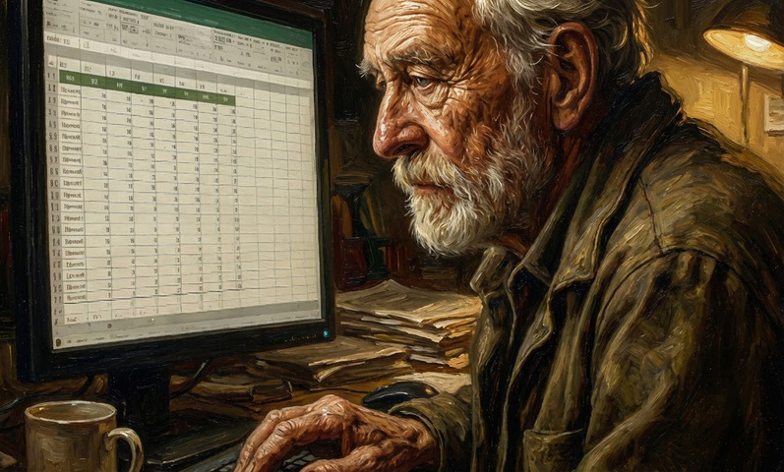
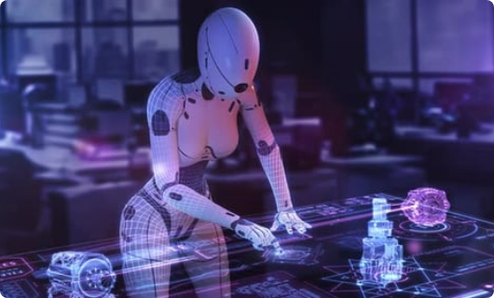
The Paradigm Shift
Era 1.0: Analysis (2012-2022)
Era 2.0: Generation (2023+)
Focus: Content Creation & Action
Focus: Descriptive Analytics
Architecture: Transformers & Diffusion
Architecture: CNNs, RNNs, LSTMs
Output: Text, Code, Video, Structures
Output: Probabilities & Classifications

Slide 3
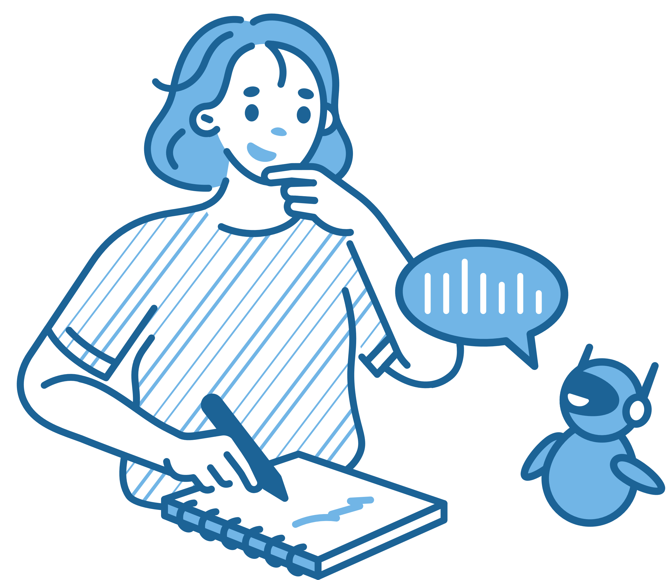
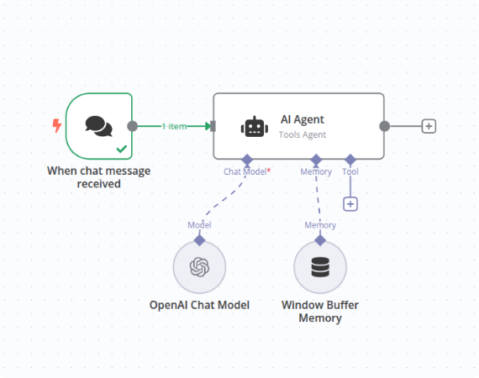
#1: The Rise of Agents
Moving from "Chatbots" to "Do-bots" (Large Action Models).
Autonomous Debugging: Agents write code, read error logs, and self-correct.
Tool Use: Agents use Browsers and APIs (Stripe, Slack, Jira).
Planning: Breaking high-level goals into 50+ executable steps.

Slide 4

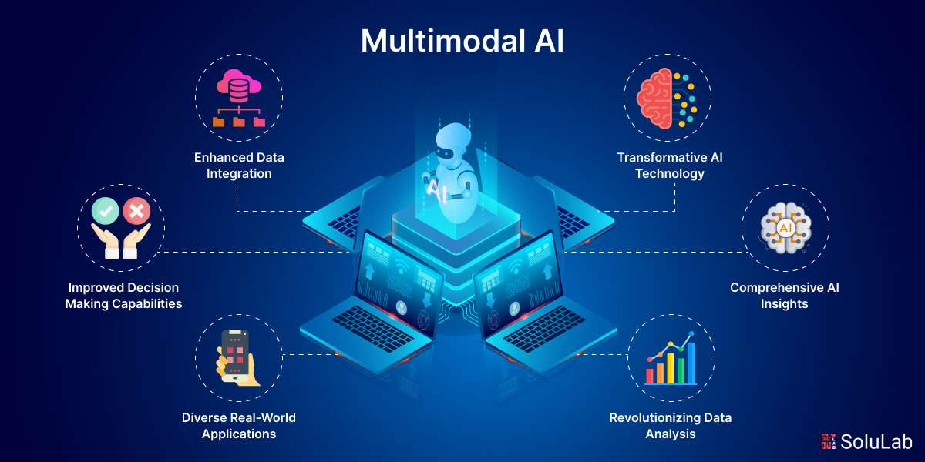
#2: Native Multimodality
The end of text-only models. AI now sees and hears.
Video Understanding: Analyzing security footage or medical scans in real-time.
Audio-to-Code: Describing a function verbally and getting python code.
Unified Training: Training on pixel + text tokens simultaneously (Gemini 1.5, GPT-4o).

Slide 5

Trend #3: Edge AI & TinyML
Processing data locally to solve the
“cloud bottleneck”.
Zero Latency (< 5ms): Critical for autonomous driving & robotics.
Federated Learning: Training models across devices without sharing raw data.
Hardware: Specialized NPUs (Neural Processing Units) in smartphones.

Slide 6
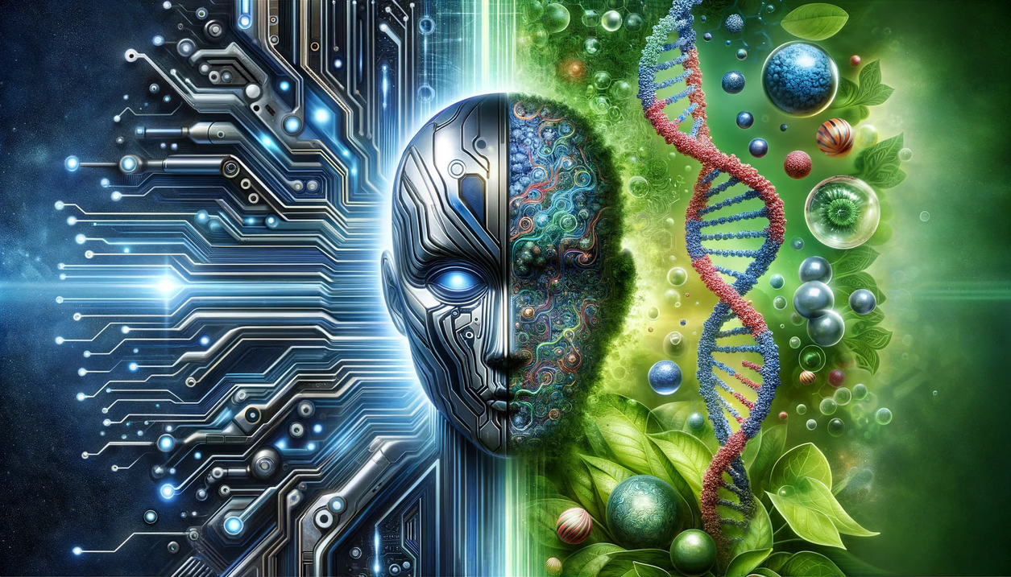
Trend #4: AI for Science
Accelerating discovery in biology and materials.
AlphaFold 3: Predicting the structure of almost all biological molecules.
GNoME: Discovering 2.2 million new crystals/materials for battery tech.
Weather Forecasting: GraphCast outperforming traditional supercomputers.

Slide 7
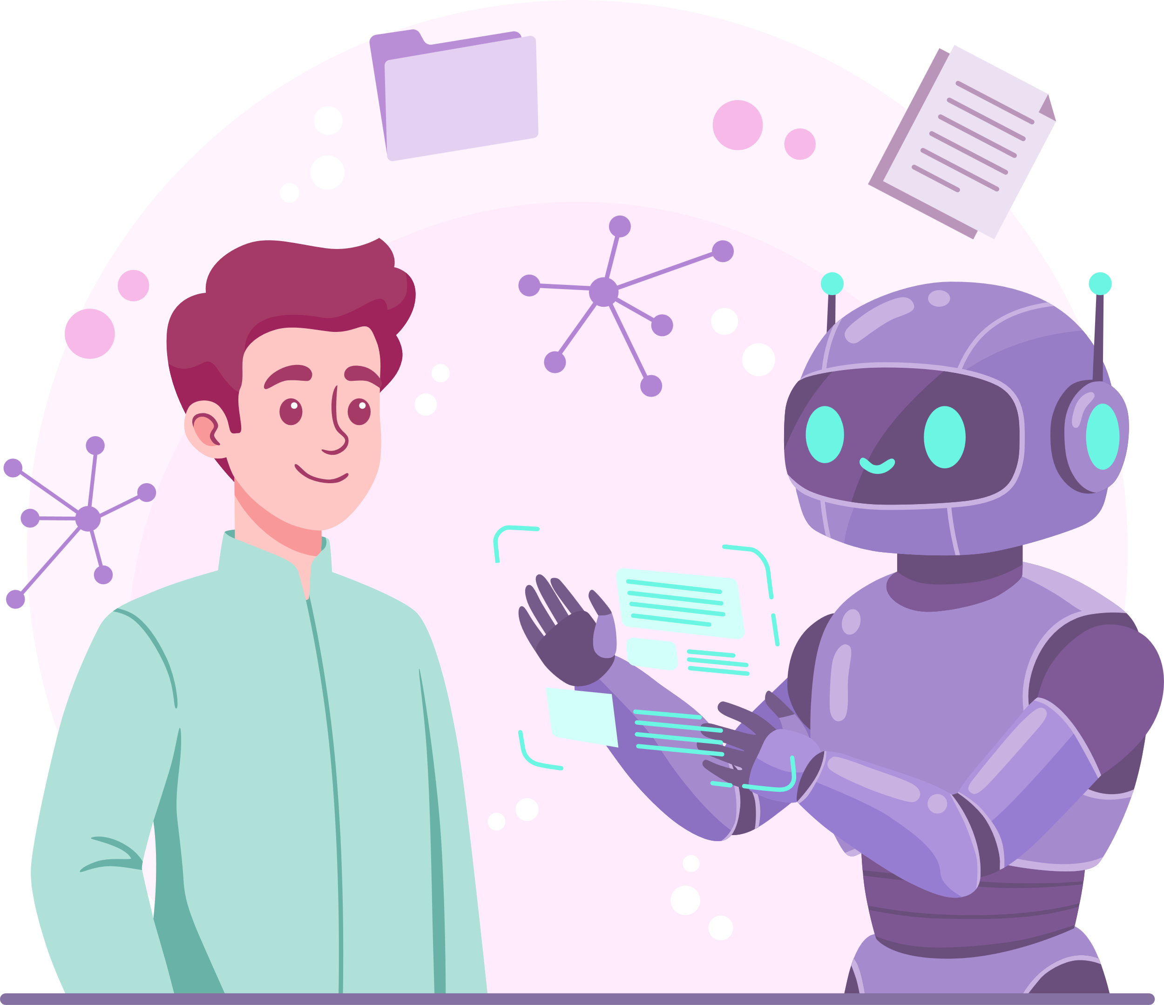

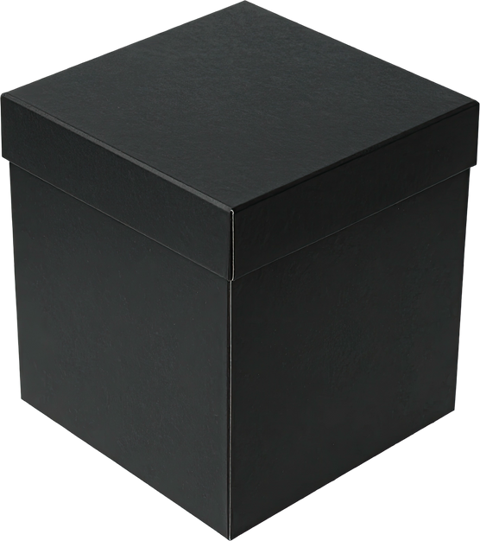

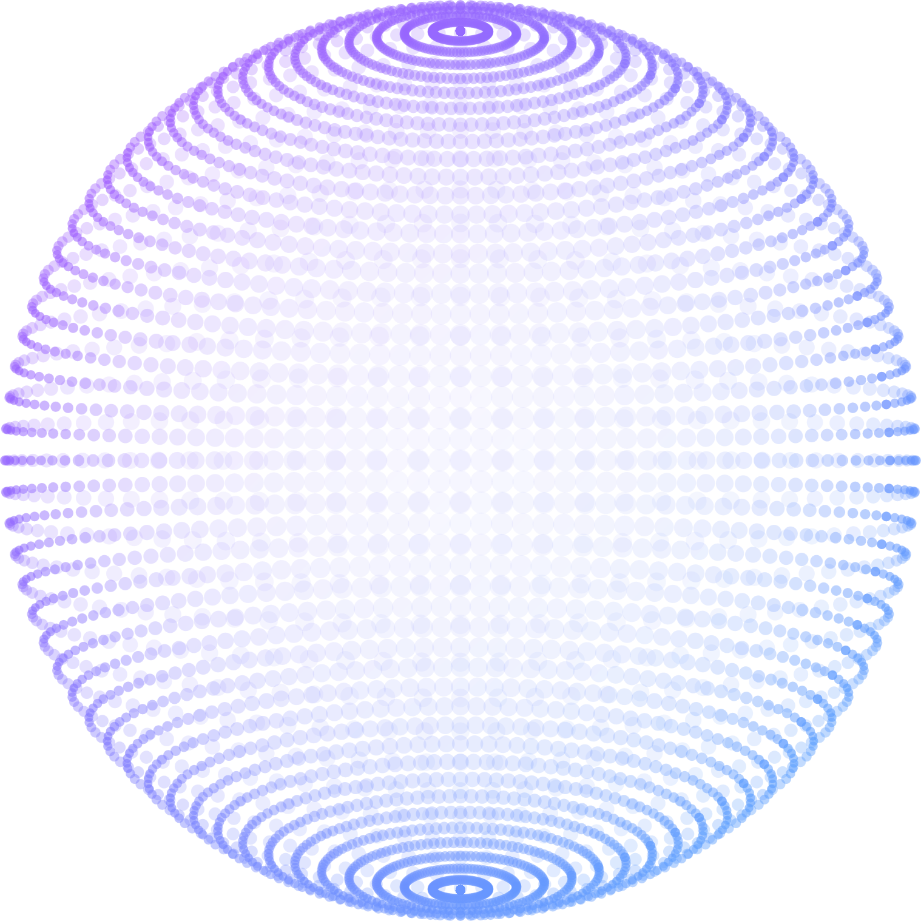
Trend #5: Explainable AI (XAI)
Trust is the barrier to adoption in Law & Medicine.
The Black Box Risk
High accuracy, zero transparency.
"Loan Denied." (Why?)
The Glass Box Solution
Using SHAP values and saliency maps.
"Denied due to debt-to-income ratio."

Slide 8

The New Professional
From Coder to System Architect.
Flow Engineering: Designing the logic flow of agents (not just prompting).
Data Curation: "Data-Centric AI" - Synthetic data generation.
Eval & Testing: Building benchmarks for hallucinations.

Slide 9


Impact: Green AI
Case Study: DeepMind & Google Data Centers.
40%
Reduction in Energy
Achieved via Reinforcement Learning control systems.
Goal: Net Zero Compute by optimizing model architecture (pruning/quantization) to reduce carbon footprint.

Slide 10

Challenges & Ethics
Navigating the Ethical Frontier.
Bias & Fairness: RLHF to prevent historical prejudice.
Deepfakes: C2PA Cryptographic watermarking.
Compliance: EU AI Act (Risk-based auditing).
Copyright: Fair use vs training data rights.

Slide 11
